Slide 1
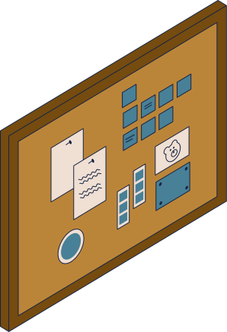
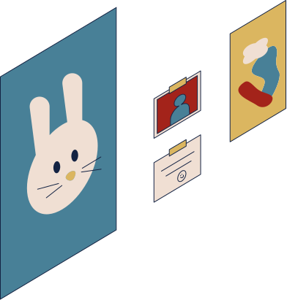
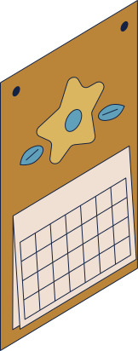
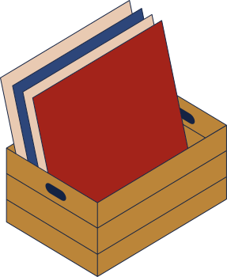
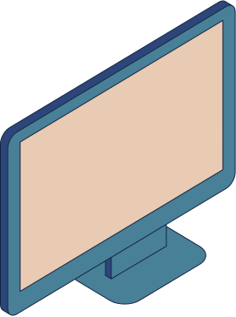
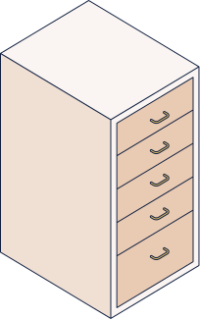
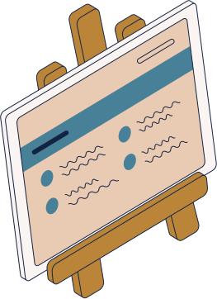
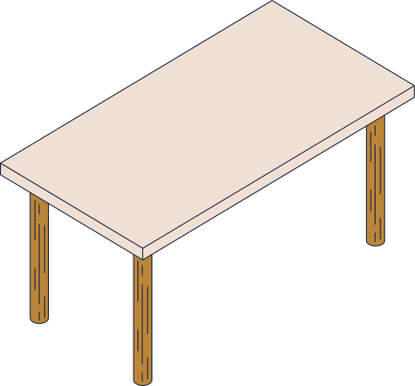
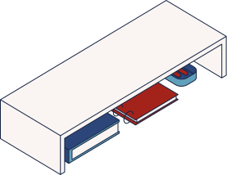
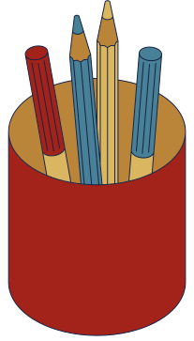
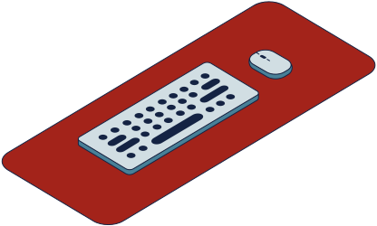
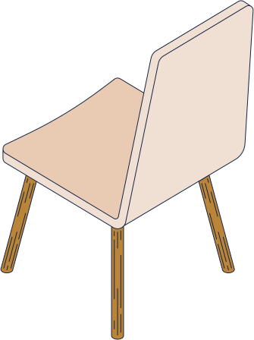
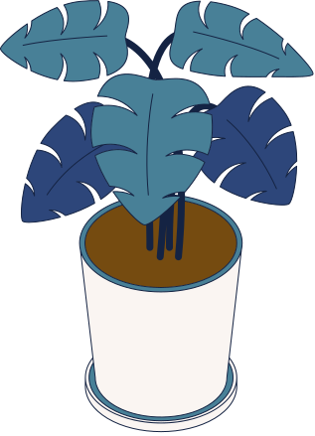
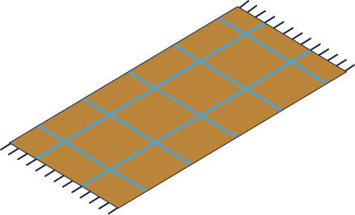
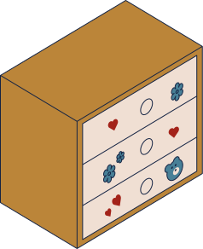
Datasoftixs Internship
Web Development
WD100284

Slide 2
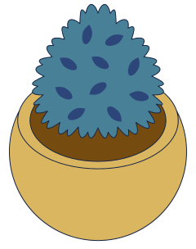
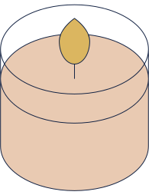
GuideLines
1
2
3
•Code: Highlight key sections of your code.
• Explanation: Provide a brief description of how your project worksf your project.
• Tools and Technologies Used: Mention all the tools, libraries, frameworks, and technologies employed.
• Output Result Screenshots: Add screenshots showcasing the results of your project.﻿

Slide 3
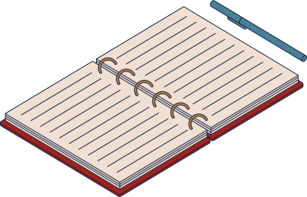
Agenda
Week 1 : My Digital Portfolio
Week 2 : Taskmaster
Week 3 : The Art explorers
Experience

Slide 4
Week 1: My Digital Portfolio

Slide 5
CODE:
*Navigation Bar*
```
<!-- Navigation Bar -->
<nav1>
<a href="#Protfolio">My Digital Protfolio </a>
</nav1>
<nav>
<ul>
<li><a href="#aboutMe">About Me | </a></li>
<li><a href="#projects">Projects |</a></li>
<li><a href="#skills">Skills |</a></li>
<li><a href="#contact">Contact</a></li>
</ul>
</nav>
```
*Main Content*
```
<!-- Main Content -->
<div class="container">
<section id="about" class="section">
<!-- About Me section content -->
</section>
<section id="projects" class="section">
<!-- Projects section content -->
</section>
<section id="skills" class="section">
<!-- Skills section content -->
</section>
<section id="contact" class="section">
<!-- Contact section content -->
</section>
</div>
```
*Responsive Design*
```
/* Responsive Design */
@media (max-width: 720px) {
.projects-container {
flex-direction: column;
align-items: center;
}
.project-card {
width: 80%;
margin-bottom: 20px;
}
}
```
*Key CSS Styles*
```
/* Body and general layout */
body {
font-family: Arial, sans-serif;
background-color: burlywood;
color: #333;
}
/* Navigation Bar */
nav {
background-color: #333;
padding: 10px 0;
text-align: left;
}
/* Container for all content */
.container {
display: grid;
grid-template-columns: 1fr;
grid-gap: 20px;
padding: 20px;
}
/* Projects Section: Flexbox layout */
.projects-container {
display: flow-root;
justify-content: space-evenly;
gap: 30px;
color: black;
}
```
Here is the revised caption:
"Thrilled to showcase my Taskmaster project for web development! Built using HTML, CSS, and JavaScript. Excited to apply these skills as a Datasoftixs intern! Just completed my 2nd week and looking forward to learning more! #Datasoftixs #webdevelopment #internship"
CODE:
*Navigation Bar*
```
<!-- Navigation Bar -->
<nav1>
<a href="#Protfolio">My Digital Protfolio </a>
</nav1>
<nav>
<ul>
<li><a href="#aboutMe">About Me | </a></li>
<li><a href="#projects">Projects |</a></li>
<li><a href="#skills">Skills |</a></li>
<li><a href="#contact">Contact</a></li>
</ul>
</nav>
```
*Main Content*
```
<!-- Main Content -->
<div class="container">
<section id="about" class="section">
<!-- About Me section content -->
</section>
<section id="projects" class="section">
<!-- Projects section content -->
</section>
<section id="skills" class="section">
<!-- Skills section content -->
</section>
<section id="contact" class="section">
<!-- Contact section content -->
</section>
</div>
```
*Responsive Design*
```
/* Responsive Design */
@media (max-width: 720px) {
.projects-container {
flex-direction: column;
align-items: center;
}
.project-card {
width: 80%;
margin-bottom: 20px;
}
}
```
*Key CSS Styles*
```
/* Body and general layout */
body {
font-family: Arial, sans-serif;
background-color: burlywood;
color: #333;
}
/* Navigation Bar */
nav {
background-color: #333;
padding: 10px 0;
text-align: left;
}
/* Container for all content */
.container {
display: grid;
grid-template-columns: 1fr;
grid-gap: 20px;
padding: 20px;
}
/* Projects Section: Flexbox layout */
.projects-container {
display: flow-root;
justify-content: space-evenly;
gap: 30px;
color: black;
}
```
Here is the revised caption:
"Thrilled to showcase my Taskmaster project for web development! Built using HTML, CSS, and JavaScript. Excited to apply these skills as a Datasoftixs intern! Just completed my 2nd week and looking forward to learning more! #Datasoftixs #webdevelopment #internship"

Slide 6
CODE:
*Navigation Bar*
```
<!-- Navigation Bar -->
<nav1>
<a href="#Protfolio">My Digital Protfolio </a>
</nav1>
<nav>
<ul>
<li><a href="#aboutMe">About Me | </a></li>
<li><a href="#projects">Projects |</a></li>
<li><a href="#skills">Skills |</a></li>
<li><a href="#contact">Contact</a></li>
</ul>
</nav>
```
*Main Content*
```
<!-- Main Content -->
<div class="container">
<section id="about" class="section">
<!-- About Me section content -->
</section>
<section id="projects" class="section">
<!-- Projects section content -->
</section>
<section id="skills" class="section">
<!-- Skills section content -->
</section>
<section id="contact" class="section">
<!-- Contact section content -->
</section>
</div>
```
*Responsive Design*
```
/* Responsive Design */
@media (max-width: 720px) {
.projects-container {
flex-direction: column;
align-items: center;
}
.project-card {
width: 80%;
margin-bottom: 20px;
}
}
```
*Key CSS Styles*
```
/* Body and general layout */
body {
font-family: Arial, sans-serif;
background-color: burlywood;
color: #333;
}
/* Navigation Bar */
nav {
background-color: #333;
padding: 10px 0;
text-align: left;
}
/* Container for all content */
.container {
display: grid;
grid-template-columns: 1fr;
grid-gap: 20px;
padding: 20px;
}
/* Projects Section: Flexbox layout */
.projects-container {
display: flow-root;
justify-content: space-evenly;
gap: 30px;
color: black;
}
```
Here is the revised caption:
"Thrilled to showcase my Taskmaster project for web development! Built using HTML, CSS, and JavaScript. Excited to apply these skills as a Datasoftixs intern! Just completed my 2nd week and looking forward to learning more! #Datasoftixs #webdevelopment #internship"
CODE:
*Navigation Bar*
```
<!-- Navigation Bar -->
<nav1>
<a href="#Protfolio">My Digital Protfolio </a>
</nav1>
<nav>
<ul>
<li><a href="#aboutMe">About Me | </a></li>
<li><a href="#projects">Projects |</a></li>
<li><a href="#skills">Skills |</a></li>
<li><a href="#contact">Contact</a></li>
</ul>
</nav>
```
*Main Content*
```
<!-- Main Content -->
<div class="container">
<section id="about" class="section">
<!-- About Me section content -->
</section>
<section id="projects" class="section">
<!-- Projects section content -->
</section>
<section id="skills" class="section">
<!-- Skills section content -->
</section>
<section id="contact" class="section">
<!-- Contact section content -->
</section>
</div>
```
*Responsive Design*
```
/* Responsive Design */
@media (max-width: 720px) {
.projects-container {
flex-direction: column;
align-items: center;
}
.project-card {
width: 80%;
margin-bottom: 20px;
}
}
```
*Key CSS Styles*
```
/* Body and general layout */
body {
font-family: Arial, sans-serif;
background-color: burlywood;
color: #333;
}
/* Navigation Bar */
nav {
background-color: #333;
padding: 10px 0;
text-align: left;
}
/* Container for all content */
.container {
display: grid;
grid-template-columns: 1fr;
grid-gap: 20px;
padding: 20px;
}
/* Projects Section: Flexbox layout */
.projects-container {
display: flow-root;
justify-content: space-evenly;
gap: 30px;
color: black;
}
```
Here is the revised caption:
"Thrilled to showcase my Taskmaster project for web development! Built using HTML, CSS, and JavaScript. Excited to apply these skills as a Datasoftixs intern! Just completed my 2nd week and looking forward to learning more! #Datasoftixs #webdevelopment #internship"

Slide 7
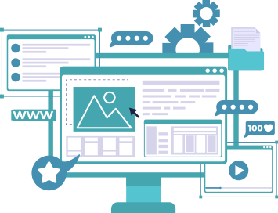

CODE:
*Navigation Bar*
```
<!-- Navigation Bar -->
<nav1>
<a href="#Protfolio">My Digital Protfolio </a>
</nav1>
<nav>
<ul>
<li><a href="#aboutMe">About Me | </a></li>
<li><a href="#projects">Projects |</a></li>
<li><a href="#skills">Skills |</a></li>
<li><a href="#contact">Contact</a></li>
</ul>
</nav>
```
*Main Content*
```
<!-- Main Content -->
<div class="container">
<section id="about" class="section">
<!-- About Me section content -->
</section>
<section id="projects" class="section">
<!-- Projects section content -->
</section>
<section id="skills" class="section">
<!-- Skills section content -->
</section>
<section id="contact" class="section">
<!-- Contact section content -->
</section>
</div>
```
*Responsive Design*
```
/* Responsive Design */
@media (max-width: 720px) {
.projects-container {
flex-direction: column;
align-items: center;
}
.project-card {
width: 80%;
margin-bottom: 20px;
}
}
```
*Key CSS Styles*
```
/* Body and general layout */
body {
font-family: Arial, sans-serif;
background-color: burlywood;
color: #333;
}
/* Navigation Bar */
nav {
background-color: #333;
padding: 10px 0;
text-align: left;
}
/* Container for all content */
.container {
display: grid;
grid-template-columns: 1fr;
grid-gap: 20px;
padding: 20px;
}
/* Projects Section: Flexbox layout */
.projects-container {
display: flow-root;
justify-content: space-evenly;
gap: 30px;
color: black;
}
```

Slide 8
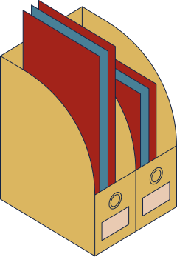
EXPLANATION:
This digital portfolio is a static website designed to showcase my skills, experience, and projects. It uses HTML for structuring the content and CSS for styling and layout. The website has three main sections: Home, Projects, and About. Each section provides a brief overview of my background, skills, and experience. The website is fully responsive and works well on various devices and screen sizes.
TOOLS AND TECHNOLOGIES:
HTML5
CSS3
Visual Studio Code (code editor)
Google Chrome (web browser )

Slide 9
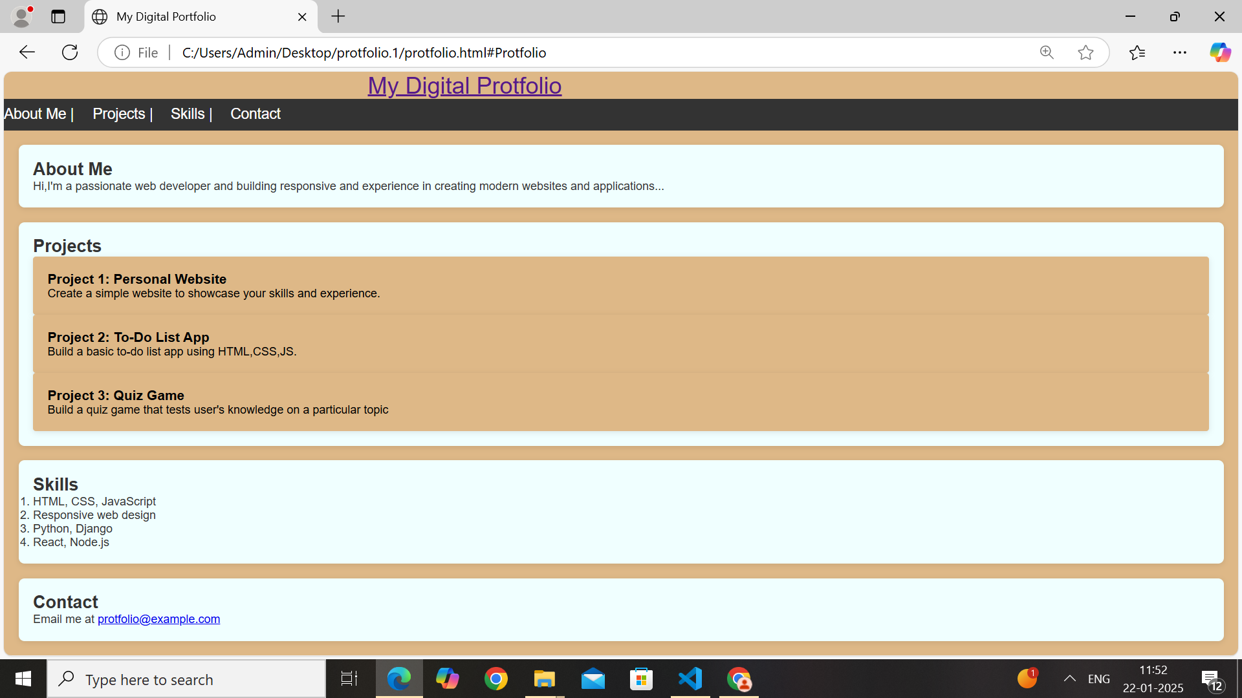
Output Result Screenshot:

Slide 10
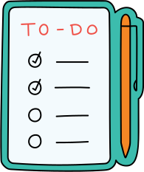
Week 2: The Taskmaster

Slide 11
CODE:
*HTML Structure*
```
<!-- Task Master container -->
<div class="task-master-container">
<h1>Task Master</h1>
<input type="text" id="task-input" placeholder="Enter a task">
<button id="add-task-button">Add Task</button>
<ol id="task-list"></ol>
</div>
```
*CSS Styles*
```
/* Task Master container styles */
.task-master-container {
width: 80%;
margin: 40px auto;
background-color: skyblue;
padding: 40px;
border: 2px solid blue;
box-shadow: 0 0 10px rgba(0, 0, 0, 0.1);
font-style: bold;
border-style: dashed;
}
/* Task input styles */
#task-input {
width: 80%;
padding: 10px;
font-size: 18px;
border: none;
border-radius: 5px;
background-color: #f0f0f0;
}
/* Add task button styles */
#add-task-button {
padding: 20px;
font-size: 18px;
border: none;
border-radius: 5px;
background-color: black;
color: #fff;
cursor: pointer;
}
```
*JavaScript Code*
*Get Elements*
```
// Get task list element
const taskListElement = document.getElementById("task-list");
// Get task input element
const taskInputElement = document.getElementById("task-input");
// Get add task button element
const addTaskButtonElement = document.getElementById("add-task-button");
```
*Task List Array*
```
// Task list array
let taskList = JSON.parse(localStorage.getItem("taskList")) || [];
```
*Add Event Listeners*
```
// Add event listeners
addTaskButtonElement.addEventListener("click", addTask);
taskInputElement.addEventListener("keypress", (e) => {
if (e.key === "Enter") {
addTask();
}
});
```
*Add Task Function*
```
// Add task function
function addTask() {
const task = taskInputElement.value.trim();
if (task) {
taskList.push({ task, completed: false });
localStorage.setItem("taskList", JSON.stringify(taskList));
renderTaskList();
taskInputElement.value = "";
}
}
```
*Render Task List Function*
```
// Render task list function
function renderTaskList() {
taskListElement.innerHTML = "";
taskList.forEach((task, index) => {
const taskElement = document.createElement("li");
taskElement.textContent = task.task;
if (task.completed) {
taskElement.classList.add("completed");
}
taskElement.addEventListener("click", () => {
task.completed = !task.completed;
localStorage.setItem("taskList", JSON.stringify(taskList));
renderTaskList();
});
const deleteButtonElement = document.createElement("button");
deleteButtonElement.textContent = "Remove";
deleteButtonElement.addEventListener("click", () => {
taskList.splice(index, 1);
localStorage.setItem("taskList", JSON.stringify(taskList));
renderTaskList();
});
taskElement.appendChild(deleteButtonElement);
taskListElement.appendChild(taskElement);
});
}
```
*Initial Render*
```
// Initial render
renderTaskList();
```
This digital portfolio is a static website designed to showcas screen sizes.
CODE:
*HTML Structure*
```
<!-- Task Master container -->
<div class="task-master-container">
<h1>Task Master</h1>
<input type="text" id="task-input" placeholder="Enter a task">
<button id="add-task-button">Add Task</button>
<ol id="task-list"></ol>
</div>
```
*CSS Styles*
```
/* Task Master container styles */
.task-master-container {
width: 80%;
margin: 40px auto;
background-color: skyblue;
padding: 40px;
border: 2px solid blue;
box-shadow: 0 0 10px rgba(0, 0, 0, 0.1);
font-style: bold;
border-style: dashed;
}
/* Task input styles */
#task-input {
width: 80%;
padding: 10px;
font-size: 18px;
border: none;
border-radius: 5px;
background-color: #f0f0f0;
}
/* Add task button styles */
#add-task-button {
padding: 20px;
font-size: 18px;
border: none;
border-radius: 5px;
background-color: black;
color: #fff;
cursor: pointer;
}
```
*JavaScript Code*
*Get Elements*
```
// Get task list element
const taskListElement = document.getElementById("task-list");
// Get task input element
const taskInputElement = document.getElementById("task-input");
// Get add task button element
const addTaskButtonElement = document.getElementById("add-task-button");
```
*Task List Array*
```
// Task list array
let taskList = JSON.parse(localStorage.getItem("taskList")) || [];
```
*Add Event Listeners*
```
// Add event listeners
addTaskButtonElement.addEventListener("click", addTask);
taskInputElement.addEventListener("keypress", (e) => {
if (e.key === "Enter") {
addTask();
}
});
```
*Add Task Function*
```
// Add task function
function addTask() {
const task = taskInputElement.value.trim();
if (task) {
taskList.push({ task, completed: false });
localStorage.setItem("taskList", JSON.stringify(taskList));
renderTaskList();
taskInputElement.value = "";
}
}
```
*Render Task List Function*
```
// Render task list function
function renderTaskList() {
taskListElement.innerHTML = "";
taskList.forEach((task, index) => {
const taskElement = document.createElement("li");
taskElement.textContent = task.task;
if (task.completed) {
taskElement.classList.add("completed");
}
taskElement.addEventListener("click", () => {
task.completed = !task.completed;
localStorage.setItem("taskList", JSON.stringify(taskList));
renderTaskList();
});
const deleteButtonElement = document.createElement("button");
deleteButtonElement.textContent = "Remove";
deleteButtonElement.addEventListener("click", () => {
taskList.splice(index, 1);
localStorage.setItem("taskList", JSON.stringify(taskList));
renderTaskList();
});
taskElement.appendChild(deleteButtonElement);
taskListElement.appendChild(taskElement);
});
}
```
*Initial Render*
```
// Initial render
renderTaskList();
```
This digital portfolio is a static website designed to showcas screen sizes.

Slide 12
CODE:
*HTML Structure*
```
<!-- Task Master container -->
<div class="task-master-container">
<h1>Task Master</h1>
<input type="text" id="task-input" placeholder="Enter a task">
<button id="add-task-button">Add Task</button>
<ol id="task-list"></ol>
</div>
```
*CSS Styles*
```
/* Task Master container styles */
.task-master-container {
width: 80%;
margin: 40px auto;
background-color: skyblue;
padding: 40px;
border: 2px solid blue;
box-shadow: 0 0 10px rgba(0, 0, 0, 0.1);
font-style: bold;
border-style: dashed;
}
/* Task input styles */
#task-input {
width: 80%;
padding: 10px;
font-size: 18px;
border: none;
border-radius: 5px;
background-color: #f0f0f0;
}
/* Add task button styles */
#add-task-button {
padding: 20px;
font-size: 18px;
border: none;
border-radius: 5px;
background-color: black;
color: #fff;
cursor: pointer;
}
```
*JavaScript Code*
*Get Elements*
```
// Get task list element
const taskListElement = document.getElementById("task-list");
// Get task input element
const taskInputElement = document.getElementById("task-input");
// Get add task button element
const addTaskButtonElement = document.getElementById("add-task-button");
```
*Task List Array*
```
// Task list array
let taskList = JSON.parse(localStorage.getItem("taskList")) || [];
```
*Add Event Listeners*
```
// Add event listeners
addTaskButtonElement.addEventListener("click", addTask);
taskInputElement.addEventListener("keypress", (e) => {
if (e.key === "Enter") {
addTask();
}
});
```
*Add Task Function*
```
// Add task function
function addTask() {
const task = taskInputElement.value.trim();
if (task) {
taskList.push({ task, completed: false });
localStorage.setItem("taskList", JSON.stringify(taskList));
renderTaskList();
taskInputElement.value = "";
}
}
```
*Render Task List Function*
```
// Render task list function
function renderTaskList() {
taskListElement.innerHTML = "";
taskList.forEach((task, index) => {
const taskElement = document.createElement("li");
taskElement.textContent = task.task;
if (task.completed) {
taskElement.classList.add("completed");
}
taskElement.addEventListener("click", () => {
task.completed = !task.completed;
localStorage.setItem("taskList", JSON.stringify(taskList));
renderTaskList();
});
const deleteButtonElement = document.createElement("button");
deleteButtonElement.textContent = "Remove";
deleteButtonElement.addEventListener("click", () => {
taskList.splice(index, 1);
localStorage.setItem("taskList", JSON.stringify(taskList));
renderTaskList();
});
taskElement.appendChild(deleteButtonElement);
taskListElement.appendChild(taskElement);
});
}
```
*Initial Render*
```
// Initial render
renderTaskList();
```
This digital portfolio is a static website designed to showcas screen sizes.
CODE:
*HTML Structure*
```
<!-- Task Master container -->
<div class="task-master-container">
<h1>Task Master</h1>
<input type="text" id="task-input" placeholder="Enter a task">
<button id="add-task-button">Add Task</button>
<ol id="task-list"></ol>
</div>
```
*CSS Styles*
```
/* Task Master container styles */
.task-master-container {
width: 80%;
margin: 40px auto;
background-color: skyblue;
padding: 40px;
border: 2px solid blue;
box-shadow: 0 0 10px rgba(0, 0, 0, 0.1);
font-style: bold;
border-style: dashed;
}
/* Task input styles */
#task-input {
width: 80%;
padding: 10px;
font-size: 18px;
border: none;
border-radius: 5px;
background-color: #f0f0f0;
}
/* Add task button styles */
#add-task-button {
padding: 20px;
font-size: 18px;
border: none;
border-radius: 5px;
background-color: black;
color: #fff;
cursor: pointer;
}
```
*JavaScript Code*
*Get Elements*
```
// Get task list element
const taskListElement = document.getElementById("task-list");
// Get task input element
const taskInputElement = document.getElementById("task-input");
// Get add task button element
const addTaskButtonElement = document.getElementById("add-task-button");
```
*Task List Array*
```
// Task list array
let taskList = JSON.parse(localStorage.getItem("taskList")) || [];
```
*Add Event Listeners*
```
// Add event listeners
addTaskButtonElement.addEventListener("click", addTask);
taskInputElement.addEventListener("keypress", (e) => {
if (e.key === "Enter") {
addTask();
}
});
```
*Add Task Function*
```
// Add task function
function addTask() {
const task = taskInputElement.value.trim();
if (task) {
taskList.push({ task, completed: false });
localStorage.setItem("taskList", JSON.stringify(taskList));
renderTaskList();
taskInputElement.value = "";
}
}
```
*Render Task List Function*
```
// Render task list function
function renderTaskList() {
taskListElement.innerHTML = "";
taskList.forEach((task, index) => {
const taskElement = document.createElement("li");
taskElement.textContent = task.task;
if (task.completed) {
taskElement.classList.add("completed");
}
taskElement.addEventListener("click", () => {
task.completed = !task.completed;
localStorage.setItem("taskList", JSON.stringify(taskList));
renderTaskList();
});
const deleteButtonElement = document.createElement("button");
deleteButtonElement.textContent = "Remove";
deleteButtonElement.addEventListener("click", () => {
taskList.splice(index, 1);
localStorage.setItem("taskList", JSON.stringify(taskList));
renderTaskList();
});
taskElement.appendChild(deleteButtonElement);
taskListElement.appendChild(taskElement);
});
}
```
*Initial Render*
```
// Initial render
renderTaskList();
```
This digital portfolio is a static website designed to showcas screen sizes.

Slide 13
CODE:
*HTML Structure*
```
<!-- Task Master container -->
<div class="task-master-container">
<h1>Task Master</h1>
<input type="text" id="task-input" placeholder="Enter a task">
<button id="add-task-button">Add Task</button>
<ol id="task-list"></ol>
</div>
```
*CSS Styles*
```
/* Task Master container styles */
.task-master-container {
width: 80%;
margin: 40px auto;
background-color: skyblue;
padding: 40px;
border: 2px solid blue;
box-shadow: 0 0 10px rgba(0, 0, 0, 0.1);
font-style: bold;
border-style: dashed;
}
/* Task input styles */
#task-input {
width: 80%;
padding: 10px;
font-size: 18px;
border: none;
border-radius: 5px;
background-color: #f0f0f0;
}
/* Add task button styles */
#add-task-button {
padding: 20px;
font-size: 18px;
border: none;
border-radius: 5px;
background-color: black;
color: #fff;
cursor: pointer;
}
```
*JavaScript Code*
*Get Elements*
```
// Get task list element
const taskListElement = document.getElementById("task-list");
// Get task input element
const taskInputElement = document.getElementById("task-input");
// Get add task button element
const addTaskButtonElement = document.getElementById("add-task-button");
```
*Task List Array*
```
// Task list array
let taskList = JSON.parse(localStorage.getItem("taskList")) || [];
```
*Add Event Listeners*
```
// Add event listeners
addTaskButtonElement.addEventListener("click", addTask);
taskInputElement.addEventListener("keypress", (e) => {
if (e.key === "Enter") {
addTask();
}
});
```
*Add Task Function*
```
// Add task function
function addTask() {
const task = taskInputElement.value.trim();
if (task) {
taskList.push({ task, completed: false });
localStorage.setItem("taskList", JSON.stringify(taskList));
renderTaskList();
taskInputElement.value = "";
}
}
```
*Render Task List Function*
```
// Render task list function
function renderTaskList() {
taskListElement.innerHTML = "";
taskList.forEach((task, index) => {
const taskElement = document.createElement("li");
taskElement.textContent = task.task;
if (task.completed) {
taskElement.classList.add("completed");
}
taskElement.addEventListener("click", () => {
task.completed = !task.completed;
localStorage.setItem("taskList", JSON.stringify(taskList));
renderTaskList();
});
const deleteButtonElement = document.createElement("button");
deleteButtonElement.textContent = "Remove";
deleteButtonElement.addEventListener("click", () => {
taskList.splice(index, 1);
localStorage.setItem("taskList", JSON.stringify(taskList));
renderTaskList();
});
taskElement.appendChild(deleteButtonElement);
taskListElement.appendChild(taskElement);
});
}
`Imitial Render*
// Initial render
renderTaskList();
```
This digital portfolio is a static website designed to showcas screen sizes.
CODE:
*HTML Structure*
```
<!-- Task Master container -->
<div class="task-master-container">
<h1>Task Master</h1>
<input type="text" id="task-input" placeholder="Enter a task">
<button id="add-task-button">Add Task</button>
<ol id="task-list"></ol>
</div>
```
*CSS Styles*
```
/* Task Master container styles */
.task-master-container {
width: 80%;
margin: 40px auto;
background-color: skyblue;
padding: 40px;
border: 2px solid blue;
box-shadow: 0 0 10px rgba(0, 0, 0, 0.1);
font-style: bold;
border-style: dashed;
}
/* Task input styles */
#task-input {
width: 80%;
padding: 10px;
font-size: 18px;
border: none;
border-radius: 5px;
background-color: #f0f0f0;
}
/* Add task button styles */
#add-task-button {
padding: 20px;
font-size: 18px;
border: none;
border-radius: 5px;
background-color: black;
color: #fff;
cursor: pointer;
}
```
*JavaScript Code*
*Get Elements*
```
// Get task list element
const taskListElement = document.getElementById("task-list");
// Get task input element
const taskInputElement = document.getElementById("task-input");
// Get add task button element
const addTaskButtonElement = document.getElementById("add-task-button");
```
*Task List Array*
```
// Task list array
let taskList = JSON.parse(localStorage.getItem("taskList")) || [];
```
*Add Event Listeners*
```
// Add event listeners
addTaskButtonElement.addEventListener("click", addTask);
taskInputElement.addEventListener("keypress", (e) => {
if (e.key === "Enter") {
addTask();
}
});
```
*Add Task Function*
```
// Add task function
function addTask() {
const task = taskInputElement.value.trim();
if (task) {
taskList.push({ task, completed: false });
localStorage.setItem("taskList", JSON.stringify(taskList));
renderTaskList();
taskInputElement.value = "";
}
}
```
*Render Task List Function*
```
// Render task list function
function renderTaskList() {
taskListElement.innerHTML = "";
taskList.forEach((task, index) => {
const taskElement = document.createElement("li");
taskElement.textContent = task.task;
if (task.completed) {
taskElement.classList.add("completed");
}
taskElement.addEventListener("click", () => {
task.completed = !task.completed;
localStorage.setItem("taskList", JSON.stringify(taskList));
renderTaskList();
});
const deleteButtonElement = document.createElement("button");
deleteButtonElement.textContent = "Remove";
deleteButtonElement.addEventListener("click", () => {
taskList.splice(index, 1);
localStorage.setItem("taskList", JSON.stringify(taskList));
renderTaskList();
});
taskElement.appendChild(deleteButtonElement);
taskListElement.appendChild(taskElement);
});
}
```
*Initial Render*
```
// Initial render
renderTaskList();
```
This digital portfolio is a static website designed to showcas screen sizes.

Slide 14
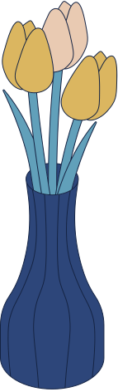
EXPLANATION:.
Taskmaster is a simple task management application that allows users to add, edit, and delete tasks. The application uses HTML for structuring the content, CSS for styling and layout, and JavaScript for adding interactivity. Users can add new tasks, view existing tasks, and delete tasks. The application also uses LocalStorage API to store tasks locally in the browser.
TOOLS AND TECHNOLOGIES:
HTML5
CSS3
Javascript
Visual studio code(code editor)
Google Chrome(web browser)

Slide 15
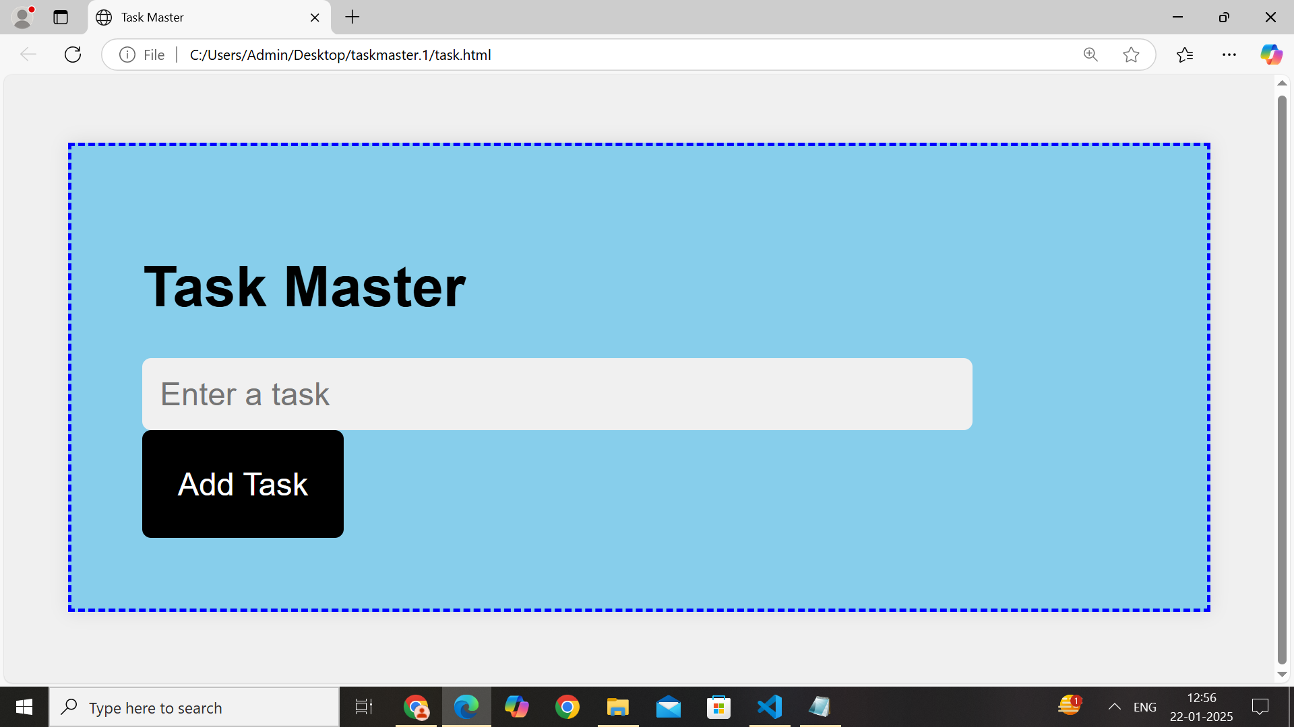
Output Result Screenshot:

Slide 16
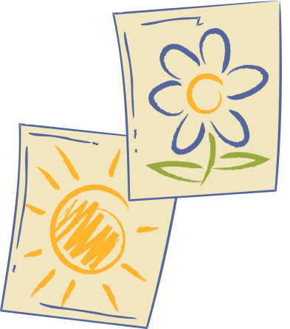
Week 3: The ART Explorer

Slide 17
CODE:
*HTML Structure*
```
<!-- Gallery container -->
<div class="gallery">
<!-- Filters and buttons -->
<div class="filters">
<!-- Filter buttons -->
<div class="my-button">
<button>Gallery</button>
<button>Photography</button>
<button>Painting</button>
</div>
</div>
<!-- Image grid -->
<div class="image-grid">
<!-- Images will be generated dynamically -->
</div>
<!-- Modal for image preview -->
<div class="modal">
<img src="" alt="" class="modal-img">
<button class="modal-close">&times;</button>
</div>
</div>
```
*CSS Styles*
```
/* Gallery container styles */
.gallery {
max-width: 1200px;
margin: 40px auto;
padding: 20px;
background-color: lightgreen;
border: 1px solid #ddd;
box-shadow: 0 0 10px rgba(0, 0, 0, 0.1);
}
/* Image grid styles */
.image-grid {
display: grid;
grid-template-columns: repeat(3, 1fr);
grid-gap: 30px;
}
/* Modal styles */
.modal {
position: fixed;
top: 0;
right: 0;
bottom: 0;
left: 0;
background-color: rgba(0, 0, 0, 0.5);
display: none;
}
```
*JavaScript Code*
*Image Data*
```
// Sample data for images
const images = [
{ id: 1, src: 'image1.jpg', category: 'painting' },
{ id: 2, src: 'image2.jpg', category: 'photography' },
{ id: 3, src: 'image3.jpg', category: 'painting' },
// Add more images here...
];
```
*Functions*
```
// Function to generate image grid
function generateImageGrid() {
const imageGrid = document.querySelector('.image-grid');
imageGrid.innerHTML = '';
images.forEach((image) => {
const img = document.createElement('img');
img.src = image.src;
img.dataset.category = image.category;
imageGrid.appendChild(img);
});
}
// Function to handle filter button clicks
function handleFilterButtonClick(event) {
const filterValue = event.target.dataset.filter;
const imagesToDisplay = images.filter((image) => {
if (filterValue === 'all') {
return true;
}
return image.category === filterValue;
});
generateImageGrid(imagesToDisplay);
}
// Function to handle image clicks
function handleImageClick(event) {
const modal = document.querySelector('.modal');
const modalImg = document.querySelector('.modal-img');
modalImg.src = event.target.src;
modal.style.display = 'block';
}
// Function to handle modal close button clicks
function handleModalCloseButtonClick() {
const modal = document.querySelector('.modal');
modal.style.display = 'none';
}
```
*Event Listeners*
```
// Add event listeners
document.querySelectorAll('.filter-btn').forEach((button) => {
button.addEventListener('click', handleFilterButtonClick);
});
document.querySelector('.image-grid').addEventListener('click', handleImageClick);
document.querySelector('.modal-close').addEventListener('click', handleModalCloseButtonClick);
// Generate image grid on page load
generateImageGrid();
```
This digital portfolio is a static website designed to showcase my skills, experience, and projects. It uses HTML for structuring the content and CSS for styling and layout. The website has three main sections: Home, Projects, and About. Each section provides a brief overview of my background, skills, and experience. The website is fully responsive and works well on various devices and screen sizes.
CODE:
*HTML Structure*
```
<!-- Gallery container -->
<div class="gallery">
<!-- Filters and buttons -->
<div class="filters">
<!-- Filter buttons -->
<div class="my-button">
<button>Gallery</button>
<button>Photography</button>
<button>Painting</button>
</div>
</div>
<!-- Image grid -->
<div class="image-grid">
<!-- Images will be generated dynamically -->
</div>
<!-- Modal for image preview -->
<div class="modal">
<img src="" alt="" class="modal-img">
<button class="modal-close">&times;</button>
</div>
</div>
```
*CSS Styles*
```
/* Gallery container styles */
.gallery {
max-width: 1200px;
margin: 40px auto;
padding: 20px;
background-color: lightgreen;
border: 1px solid #ddd;
box-shadow: 0 0 10px rgba(0, 0, 0, 0.1);
}
/* Image grid styles */
.image-grid {
display: grid;
grid-template-columns: repeat(3, 1fr);
grid-gap: 30px;
}
/* Modal styles */
.modal {
position: fixed;
top: 0;
right: 0;
bottom: 0;
left: 0;
background-color: rgba(0, 0, 0, 0.5);
display: none;
}
```
*JavaScript Code*
*Image Data*
```
// Sample data for images
const images = [
{ id: 1, src: 'image1.jpg', category: 'painting' },
{ id: 2, src: 'image2.jpg', category: 'photography' },
{ id: 3, src: 'image3.jpg', category: 'painting' },
// Add more images here...
];
```
*Functions*
```
// Function to generate image grid
function generateImageGrid() {
const imageGrid = document.querySelector('.image-grid');
imageGrid.innerHTML = '';
images.forEach((image) => {
const img = document.createElement('img');
img.src = image.src;
img.dataset.category = image.category;
imageGrid.appendChild(img);
});
}
// Function to handle filter button clicks
function handleFilterButtonClick(event) {
const filterValue = event.target.dataset.filter;
const imagesToDisplay = images.filter((image) => {
if (filterValue === 'all') {
return true;
}
return image.category === filterValue;
});
generateImageGrid(imagesToDisplay);
}
// Function to handle image clicks
function handleImageClick(event) {
const modal = document.querySelector('.modal');
const modalImg = document.querySelector('.modal-img');
modalImg.src = event.target.src;
modal.style.display = 'block';
}
// Function to handle modal close button clicks
function handleModalCloseButtonClick() {
const modal = document.querySelector('.modal');
modal.style.display = 'none';
}
```
*Event Listeners*
```
// Add event listeners
document.querySelectorAll('.filter-btn').forEach((button) => {
button.addEventListener('click', handleFilterButtonClick);
});
document.querySelector('.image-grid').addEventListener('click', handleImageClick);
document.querySelector('.modal-close').addEventListener('click', handleModalCloseButtonClick);
// Generate image grid on page load
generateImageGrid();
```
This digital portfolio is a static website designed to showcase my skills, experience, and projects. It uses HTML for structuring the content and CSS for styling and layout. The website has three main sections: Home, Projects, and About. Each section provides a brief overview of my background, skills, and experience. The website is fully responsive and works well on various devices and screen sizes.

Slide 18
CODE:
*HTML Structure*
```
<!-- Gallery container -->
<div class="gallery">
<!-- Filters and buttons -->
<div class="filters">
<!-- Filter buttons -->
<div class="my-button">
<button>Gallery</button>
<button>Photography</button>
<button>Painting</button>
</div>
</div>
<!-- Image grid -->
<div class="image-grid">
<!-- Images will be generated dynamically -->
</div>
<!-- Modal for image preview -->
<div class="modal">
<img src="" alt="" class="modal-img">
<button class="modal-close">&times;</button>
</div>
</div>
```
*CSS Styles*
```
/* Gallery container styles */
.gallery {
max-width: 1200px;
margin: 40px auto;
padding: 20px;
background-color: lightgreen;
border: 1px solid #ddd;
box-shadow: 0 0 10px rgba(0, 0, 0, 0.1);
}
/* Image grid styles */
.image-grid {
display: grid;
grid-template-columns: repeat(3, 1fr);
grid-gap: 30px;
}
/* Modal styles */
.modal {
position: fixed;
top: 0;
right: 0;
bottom: 0;
left: 0;
background-color: rgba(0, 0, 0, 0.5);
display: none;
}
```
*JavaScript Code*
*Image Data*
```
// Sample data for images
const images = [
{ id: 1, src: 'image1.jpg', category: 'painting' },
{ id: 2, src: 'image2.jpg', category: 'photography' },
{ id: 3, src: 'image3.jpg', category: 'painting' },
// Add more images here...
];
```
*Functions*
```
// Function to generate image grid
function generateImageGrid() {
const imageGrid = document.querySelector('.image-grid');
imageGrid.innerHTML = '';
images.forEach((image) => {
const img = document.createElement('img');
img.src = image.src;
img.dataset.category = image.category;
imageGrid.appendChild(img);
});
}
// Function to handle filter button clicks
function handleFilterButtonClick(event) {
const filterValue = event.target.dataset.filter;
const imagesToDisplay = images.filter((image) => {
if (filterValue === 'all') {
return true;
}
return image.category === filterValue;
});
generateImageGrid(imagesToDisplay);
}
// Function to handle image clicks
function handleImageClick(event) {
const modal = document.querySelector('.modal');
const modalImg = document.querySelector('.modal-img');
modalImg.src = event.target.src;
modal.style.display = 'block';
}
// Function to handle modal close button clicks
function handleModalCloseButtonClick() {
const modal = document.querySelector('.modal');
modal.style.display = 'none';
}
```
*Event Listeners*
```
// Add event listeners
document.querySelectorAll('.filter-btn').forEach((button) => {
button.addEventListener('click', handleFilterButtonClick);
});
document.querySelector('.image-grid').addEventListener('click', handleImageClick);
document.querySelector('.modal-close').addEventListener('click', handleModalCloseButtonClick);
// Generate image grid on page load
generateImageGrid();
```
This digital portfolio is a static website designed to showcase my skills, experience, and projects. It uses HTML for structuring the content and CSS for styling and layout. The website has three main sections: Home, Projects, and About. Each section provides a brief overview of my background, skills, and experience. The website is fully responsive and works well on various devices and screen sizes.
CODE:
*HTML Structure*
```
<!-- Gallery container -->
<div class="gallery">
<!-- Filters and buttons -->
<div class="filters">
<!-- Filter buttons -->
<div class="my-button">
<button>Gallery</button>
<button>Photography</button>
<button>Painting</button>
</div>
</div>
<!-- Image grid -->
<div class="image-grid">
<!-- Images will be generated dynamically -->
</div>
<!-- Modal for image preview -->
<div class="modal">
<img src="" alt="" class="modal-img">
<button class="modal-close">&times;</button>
</div>
</div>
```
*CSS Styles*
```
/* Gallery container styles */
.gallery {
max-width: 1200px;
margin: 40px auto;
padding: 20px;
background-color: lightgreen;
border: 1px solid #ddd;
box-shadow: 0 0 10px rgba(0, 0, 0, 0.1);
}
/* Image grid styles */
.image-grid {
display: grid;
grid-template-columns: repeat(3, 1fr);
grid-gap: 30px;
}
/* Modal styles */
.modal {
position: fixed;
top: 0;
right: 0;
bottom: 0;
left: 0;
background-color: rgba(0, 0, 0, 0.5);
display: none;
}
```
*JavaScript Code*
*Image Data*
```
// Sample data for images
const images = [
{ id: 1, src: 'image1.jpg', category: 'painting' },
{ id: 2, src: 'image2.jpg', category: 'photography' },
{ id: 3, src: 'image3.jpg', category: 'painting' },
// Add more images here...
];
```
*Functions*
```
// Function to generate image grid
function generateImageGrid() {
const imageGrid = document.querySelector('.image-grid');
imageGrid.innerHTML = '';
images.forEach((image) => {
const img = document.createElement('img');
img.src = image.src;
img.dataset.category = image.category;
imageGrid.appendChild(img);
});
}
// Function to handle filter button clicks
function handleFilterButtonClick(event) {
const filterValue = event.target.dataset.filter;
const imagesToDisplay = images.filter((image) => {
if (filterValue === 'all') {
return true;
}
return image.category === filterValue;
});
generateImageGrid(imagesToDisplay);
}
// Function to handle image clicks
function handleImageClick(event) {
const modal = document.querySelector('.modal');
const modalImg = document.querySelector('.modal-img');
modalImg.src = event.target.src;
modal.style.display = 'block';
}
// Function to handle modal close button clicks
function handleModalCloseButtonClick() {
const modal = document.querySelector('.modal');
modal.style.display = 'none';
}
```
*Event Listeners*
```
// Add event listeners
document.querySelectorAll('.filter-btn').forEach((button) => {
button.addEventListener('click', handleFilterButtonClick);
});
document.querySelector('.image-grid').addEventListener('click', handleImageClick);
document.querySelector('.modal-close').addEventListener('click', handleModalCloseButtonClick);
// Generate image grid on page load
generateImageGrid();
```
This digital portfolio is a static website designed to showcase my skills, experience, and projects. It uses HTML for structuring the content and CSS for styling and layout. The website has three main sections: Home, Projects, and About. Each section provides a brief overview of my background, skills, and experience. The website is fully responsive and works well on various devices and screen sizes.

Slide 19
CODE:
*HTML Structure*
```
<!-- Gallery container -->
<div class="gallery">
<!-- Filters and buttons -->
<div class="filters">
<!-- Filter buttons -->
<div class="my-button">
<button>Gallery</button>
<button>Photography</button>
<button>Painting</button>
</div>
</div>
<!-- Image grid -->
<div class="image-grid">
<!-- Images will be generated dynamically -->
</div>
<!-- Modal for image preview -->
<div class="modal">
<img src="" alt="" class="modal-img">
<button class="modal-close">&times;</button>
</div>
</div>
```
*CSS Styles*
```
/* Gallery container styles */
.gallery {
max-width: 1200px;
margin: 40px auto;
padding: 20px;
background-color: lightgreen;
border: 1px solid #ddd;
box-shadow: 0 0 10px rgba(0, 0, 0, 0.1);
}
/* Image grid styles */
.image-grid {
display: grid;
grid-template-columns: repeat(3, 1fr);
grid-gap: 30px;
}
/* Modal styles */
.modal {
position: fixed;
top: 0;
right: 0;
bottom: 0;
left: 0;
background-color: rgba(0, 0, 0, 0.5);
display: none;
}
```
*JavaScript Code*
*Image Data*
```
// Sample data for images
const images = [
{ id: 1, src: 'image1.jpg', category: 'painting' },
{ id: 2, src: 'image2.jpg', category: 'photography' },
{ id: 3, src: 'image3.jpg', category: 'painting' },
// Add more images here...
];
```
*Functions*
```
// Function to generate image grid
function generateImageGrid() {
const imageGrid = document.querySelector('.image-grid');
imageGrid.innerHTML = '';
images.forEach((image) => {
const img = document.createElement('img');
img.src = image.src;
img.dataset.category = image.category;
imageGrid.appendChild(img);
});
}
// Function to handle filter button clicks
function handleFilterButtonClick(event) {
const filterValue = event.target.dataset.filter;
const imagesToDisplay = images.filter((image) => {
if (filterValue === 'all') {
return true;
}
return image.category === filterValue;
});
generateImageGrid(imagesToDisplay);
}
// Function to handle image clicks
function handleImageClick(event) {
const modal = document.querySelector('.modal');
const modalImg = document.querySelector('.modal-img');
modalImg.src = event.target.src;
modal.style.display = 'block';
}
// Function to handle modal close button clicks
function handleModalCloseButtonClick() {
const modal = document.querySelector('.modal');
modal.style.display = 'none';
}
```
*Event Listeners*
```
// Add event listeners
document.querySelectorAll('.filter-btn').forEach((button) => {
button.addEventListener('click', handleFilterButtonClick);
});
document.querySelector('.image-grid').addEventListener('click', handleImageClick);
document.querySelector('.modal-close').addEventListener('click', handleModalCloseButtonClick);
// Generate image grid on page load
generateImageGrid();
```
This digital portfolio is a static website designed to showcase my skills, experience, and projects. It uses HTML for structuring the content and CSS for styling and layout. The website has three main sections: Home, Projects, and About. Each section provides a brief overview of my background, skills, and experience. The website is fully responsive and works well on various devices and screen sizes.
CODE:
*HTML Structure*
```
<!-- Gallery container -->
<div class="gallery">
<!-- Filters and buttons -->
<div class="filters">
<!-- Filter buttons -->
<div class="my-button">
<button>Gallery</button>
<button>Photography</button>
<button>Painting</button>
</div>
</div>
<!-- Image grid -->
<div class="image-grid">
<!-- Images will be generated dynamically -->
</div>
<!-- Modal for image preview -->
<div class="modal">
<img src="" alt="" class="modal-img">
<button class="modal-close">&times;</button>
</div>
</div>
```
*CSS Styles*
```
/* Gallery container styles */
.gallery {
max-width: 1200px;
margin: 40px auto;
padding: 20px;
background-color: lightgreen;
border: 1px solid #ddd;
box-shadow: 0 0 10px rgba(0, 0, 0, 0.1);
}
/* Image grid styles */
.image-grid {
display: grid;
grid-template-columns: repeat(3, 1fr);
grid-gap: 30px;
}
/* Modal styles */
.modal {
position: fixed;
top: 0;
right: 0;
bottom: 0;
left: 0;
background-color: rgba(0, 0, 0, 0.5);
display: none;
}
```
*JavaScript Code*
*Image Data*
```
// Sample data for images
const images = [
{ id: 1, src: 'image1.jpg', category: 'painting' },
{ id: 2, src: 'image2.jpg', category: 'photography' },
{ id: 3, src: 'image3.jpg', category: 'painting' },
// Add more images here...
];
```
*Functions*
```
// Function to generate image grid
function generateImageGrid() {
const imageGrid = document.querySelector('.image-grid');
imageGrid.innerHTML = '';
images.forEach((image) => {
const img = document.createElement('img');
img.src = image.src;
img.dataset.category = image.category;
imageGrid.appendChild(img);
});
}
// Function to handle filter button clicks
function handleFilterButtonClick(event) {
const filterValue = event.target.dataset.filter;
const imagesToDisplay = images.filter((image) => {
if (filterValue === 'all') {
return true;
}
return image.category === filterValue;
});
generateImageGrid(imagesToDisplay);
}
// Function to handle image clicks
function handleImageClick(event) {
const modal = document.querySelector('.modal');
const modalImg = document.querySelector('.modal-img');
modalImg.src = event.target.src;
modal.style.display = 'block';
}
// Function to handle modal close button clicks
function handleModalCloseButtonClick() {
const modal = document.querySelector('.modal');
modal.style.display = 'none';
}
```
*Event Listeners*
```
// Add event listeners
document.querySelectorAll('.filter-btn').forEach((button) => {
button.addEventListener('click', handleFilterButtonClick);
});
document.querySelector('.image-grid').addEventListener('click', handleImageClick);
document.querySelector('.modal-close').addEventListener('click', handleModalCloseButtonClick);
// Generate image grid on page load
generateImageGrid();
```
This digital portfolio is a static website designed to showcase my skills, experience, and projects. It uses HTML for structuring the content and CSS for styling and layout. The website has three main sections: Home, Projects, and About. Each section provides a brief overview of my background, skills, and experience. The website is fully responsive and works well on various devices and screen sizes.

Slide 20
CODE:
*HTML Structure*
```
<!-- Gallery container -->
<div class="gallery">
<!-- Filters and buttons -->
<div class="filters">
<!-- Filter buttons -->
<div class="my-button">
<button>Gallery</button>
<button>Photography</button>
<button>Painting</button>
</div>
</div>
<!-- Image grid -->
<div class="image-grid">
<!-- Images will be generated dynamically -->
</div>
<!-- Modal for image preview -->
<div class="modal">
<img src="" alt="" class="modal-img">
<button class="modal-close">&times;</button>
</div>
</div>
```
*CSS Styles*
```
/* Gallery container styles */
.gallery {
max-width: 1200px;
margin: 40px auto;
padding: 20px;
background-color: lightgreen;
border: 1px solid #ddd;
box-shadow: 0 0 10px rgba(0, 0, 0, 0.1);
}
/* Image grid styles */
.image-grid {
display: grid;
grid-template-columns: repeat(3, 1fr);
grid-gap: 30px;
}
/* Modal styles */
.modal {
position: fixed;
top: 0;
right: 0;
bottom: 0;
left: 0;
background-color: rgba(0, 0, 0, 0.5);
display: none;
}
```
*JavaScript Code*
*Image Data*
```
// Sample data for images
const images = [
{ id: 1, src: 'image1.jpg', category: 'painting' },
{ id: 2, src: 'image2.jpg', category: 'photography' },
{ id: 3, src: 'image3.jpg', category: 'painting' },
// Add more images here...
];
```
*Functions*
```
// Function to generate image grid
function generateImageGrid() {
const imageGrid = document.querySelector('.image-grid');
imageGrid.innerHTML = '';
images.forEach((image) => {
const img = document.createElement('img');
img.src = image.src;
img.dataset.category = image.category;
imageGrid.appendChild(img);
});
}
// Function to handle filter button clicks
function handleFilterButtonClick(event) {
const filterValue = event.target.dataset.filter;
const imagesToDisplay = images.filter((image) => {
if (filterValue === 'all') {
return true;
}
return image.category === filterValue;
});
generateImageGrid(imagesToDisplay);
}
// Function to handle image clicks
function handleImageClick(event) {
const modal = document.querySelector('.modal');
const modalImg = document.querySelector('.modal-img');
modalImg.src = event.target.src;
modal.style.display = 'block';
}
// Function to handle modal close button clicks
function handleModalCloseButtonClick() {
const modal = document.querySelector('.modal');
modal.style.display = 'none';
}
```
*Event Listeners*
```
// Add event listeners
document.querySelectorAll('.filter-btn').forEach((button) => {
button.addEventListener('click', handleFilterButtonClick);
});
document.querySelector('.image-grid').addEventListener('click', handleImageClick);
document.querySelector('.modal-close').addEventListener('click', handleModalCloseButtonClick);
// Generate image grid on page load
generateImageGrid();
```
CODE:
*HTML Structure*
```
<!-- Gallery container -->
<div class="gallery">
<!-- Filters and buttons -->
<div class="filters">
<!-- Filter buttons -->
<div class="my-button">
<button>Gallery</button>
<button>Photography</button>
<button>Painting</button>
</div>
</div>
<!-- Image grid -->
<div class="image-grid">
<!-- Images will be generated dynamically -->
</div>
<!-- Modal for image preview -->
<div class="modal">
<img src="" alt="" class="modal-img">
<button class="modal-close">&times;</button>
</div>
</div>
```
*CSS Styles*
```
/* Gallery container styles */
.gallery {
max-width: 1200px;
margin: 40px auto;
padding: 20px;
background-color: lightgreen;
border: 1px solid #ddd;
box-shadow: 0 0 10px rgba(0, 0, 0, 0.1);
}
/* Image grid styles */
.image-grid {
display: grid;
grid-template-columns: repeat(3, 1fr);
grid-gap: 30px;
}
/* Modal styles */
.modal {
position: fixed;
top: 0;
right: 0;
bottom: 0;
left: 0;
background-color: rgba(0, 0, 0, 0.5);
display: none;
}
```
*JavaScript Code*
*Image Data*
```
// Sample data for images
const images = [
{ id: 1, src: 'image1.jpg', category: 'painting' },
{ id: 2, src: 'image2.jpg', category: 'photography' },
{ id: 3, src: 'image3.jpg', category: 'painting' },
// Add more images here...
];
```
*Functions*
```
// Function to generate image grid
function generateImageGrid() {
const imageGrid = document.querySelector('.image-grid');
imageGrid.innerHTML = '';
images.forEach((image) => {
const img = document.createElement('img');
img.src = image.src;
img.dataset.category = image.category;
imageGrid.appendChild(img);
});
}
// Function to handle filter button clicks
function handleFilterButtonClick(event) {
const filterValue = event.target.dataset.filter;
const imagesToDisplay = images.filter((image) => {
if (filterValue === 'all') {
return true;
}
return image.category === filterValue;
});
generateImageGrid(imagesToDisplay);
}
// Function to handle image clicks
function handleImageClick(event) {
const modal = document.querySelector('.modal');
const modalImg = document.querySelector('.modal-img');
modalImg.src = event.target.src;
modal.style.display = 'block';
}
// Function to handle modal close button clicks
function handleModalCloseButtonClick() {
const modal = document.querySelector('.modal');
modal.style.display = 'none';
}
```
*Event Listeners*
```
// Add event listeners
document.querySelectorAll('.filter-btn').forEach((button) => {
button.addEventListener('click', handleFilterButtonClick);
});
document.querySelector('.image-grid').addEventListener('click', handleImageClick);
document.querySelector('.modal-close').addEventListener('click', handleModalCloseButtonClick);
// Generate image grid on page load
generateImageGrid();
```
This digital portfolio is a static website designed to showcase my skills, experience, and projects. It uses HTML for structuring the content and CSS for styling and layout. The website has three main sections: Home, Projects, and About. Each section provides a brief overview of my background, skills, and experience. The website is fully responsive and works well on various devices and screen sizes.

Slide 21
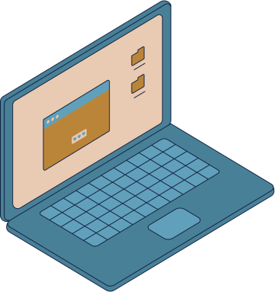
EXPLANATION:
﻿The Art Explorer is an interactive web application that allows users to explore and learn about different art styles and movements. The application uses HTML for structuring the content, CSS for styling and layout, and JavaScript for adding interactivity. Users can browse through various art styles, view images..
TOOLS AND TECHNOLOGIES:
HTML5
CSS3
Javascript
Visual studio code (code editor)
Google chrome(web browser)
Github(version control system)

Slide 22
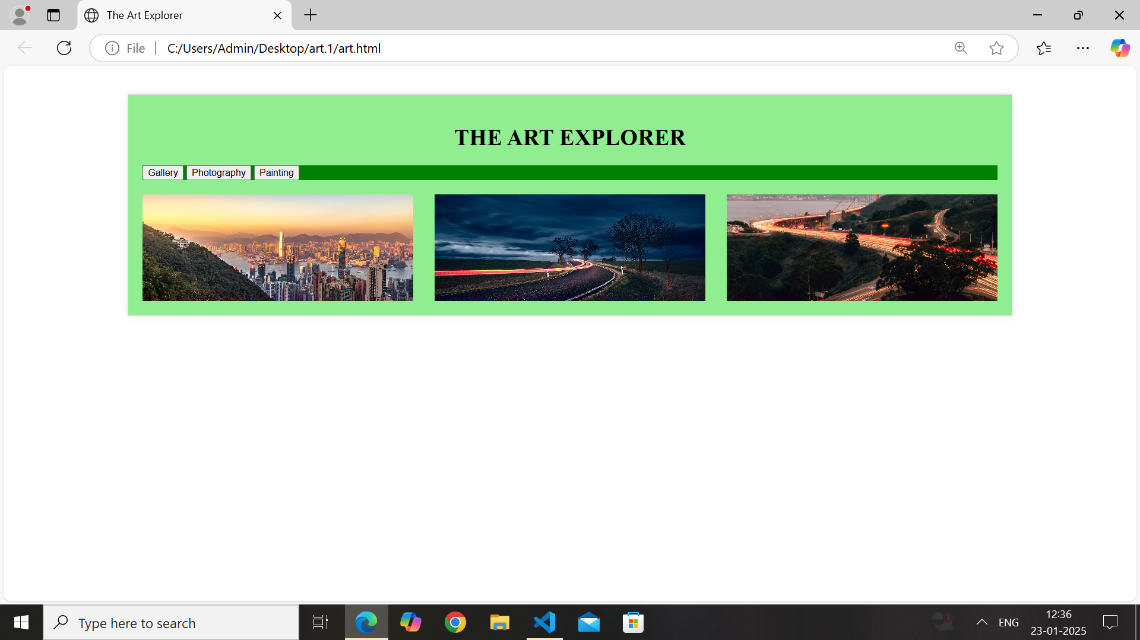
Output Result Screenshot:

Slide 23
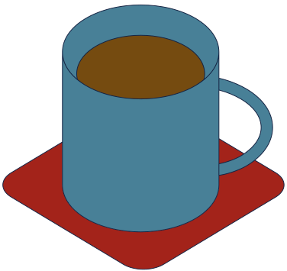
Experience
.Throughout my 3-week online internship at Datasoftixs, As a web development intern, I was tasked with contributing to various projects, and expanding my skill set in HTML, CSS, JavaScript, and other relevant technologies.
Online Internship
- Duration:3 weeks
-Format: Online (remote)
-Type:Web Development Internship
Objectives:
- Gain hands-on experience in web development
- Develop skills in HTML, CSS, JavaScript, and other relevant technologies
- Collaborate with cross-functional teams and contribute to real-world projects
- Enhance problem-solving skills, adaptability, and time management
-Deliverables:
- Complete assigned projects and tasks
- Participate in code reviews and feedback sessions
- Submit a final project report and presentation
From day one, I was struck by the company's commitment to excellence, creativity, and employee satisfaction and I found myself eager to learn, absorb, and contribute to the organization's mission.
One of the most significant benefits of this internship was the opportunity to work on real-world projects, tackling challenges, and developing solutions that had a tangible impact. I was able to apply theoretical concepts to practical problems, refining my problem-solving skills, and gaining confidence in my abilities.
The internship program at Datasoftixs was meticulously structured to ensure a comprehensive learning experience.
In addition to the technical skills I acquired, this internship helped me develop essential soft skills, such as communication, adaptability, and time management. I learned to navigate Agile methodologies, prioritize tasks, and meet deadlines, all while maintaining a high level of quality and attention to detail.
As I reflect on my experience at Datasoftixs, I am filled with gratitude and appreciation for the opportunities, challenges, and relationships I formed during my time there. This internship has not only enhanced my technical expertise but also instilled in me a deeper understanding of the web development landscape, a stronger work ethic, and a renewed passion for innovation and creativity.

Slide 24

From day one, I was struck by the company's commitment to excellence, creativity, and employee satisfaction and I found myself eager to learn, absorb, and contribute to the organization's mission.
One of the most significant benefits of this internship was the opportunity to work on real-world projects, tackling challenges, and developing solutions that had a tangible impact. I was able to apply theoretical concepts to practical problems, refining my problem-solving skills, and gaining confidence in my abilities.
The internship program at Datasoftixs was meticulously structured to ensure a comprehensive learning experience.
In addition to the technical skills I acquired, this internship helped me develop essential soft skills, such as communication, adaptability, and time management. I learned to navigate Agile methodologies, prioritize tasks, and meet deadlines, all while maintaining a high level of quality and attention to detail.
As I reflect on my experience at Datasoftixs, I am filled with gratitude and appreciate
ion for the opportunities, challenges, and relationships I formed during my time there. This internship has not only enhanced my technical expertise but also instilled in me a deeper understanding of the web development landscape, a stronger work ethic, and a renewed passion for innovation and creativity.

Slide 25
Thank you

